Slide 1
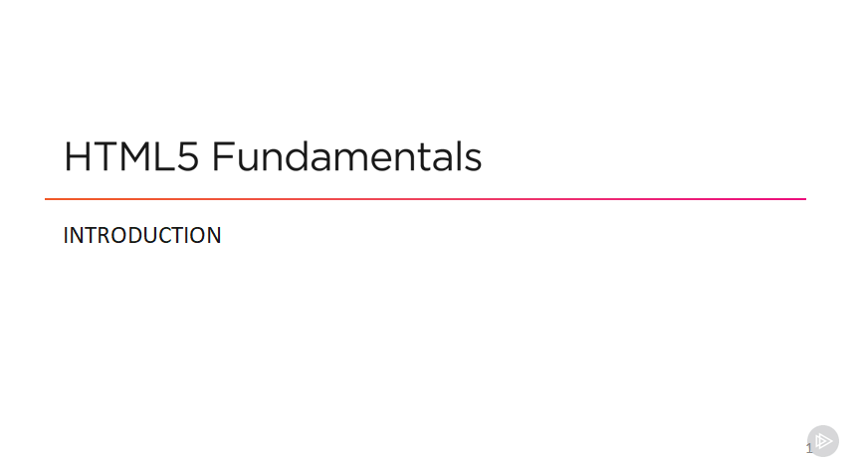

Slide 2




Slide 3
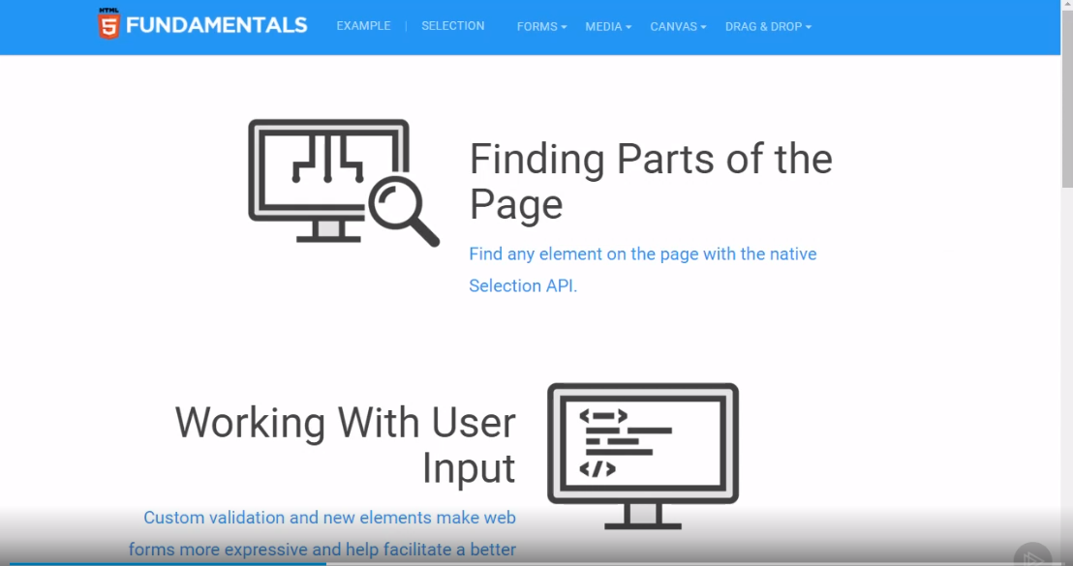

Slide 4
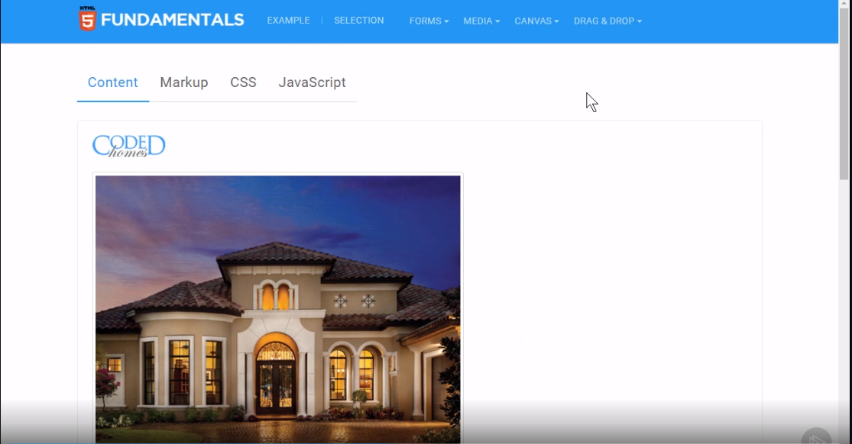

Slide 5
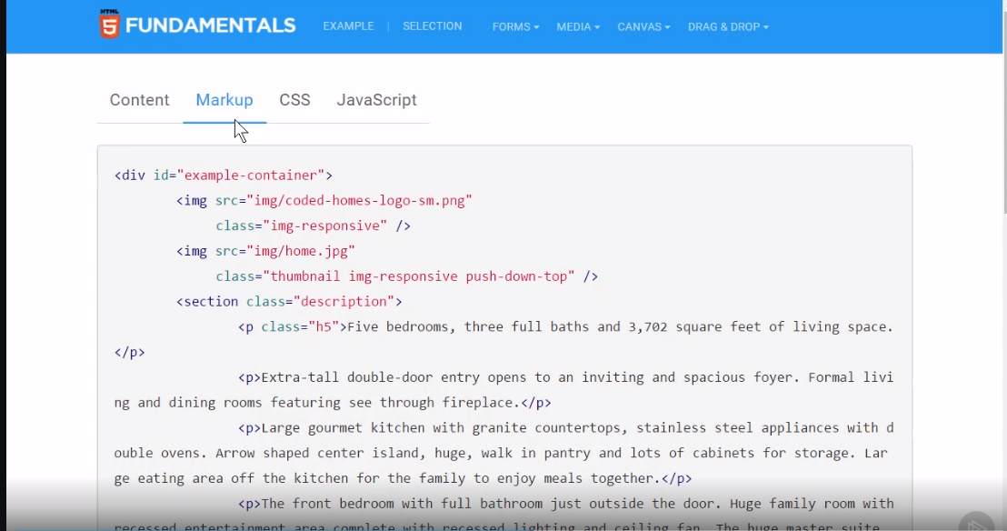

Slide 6
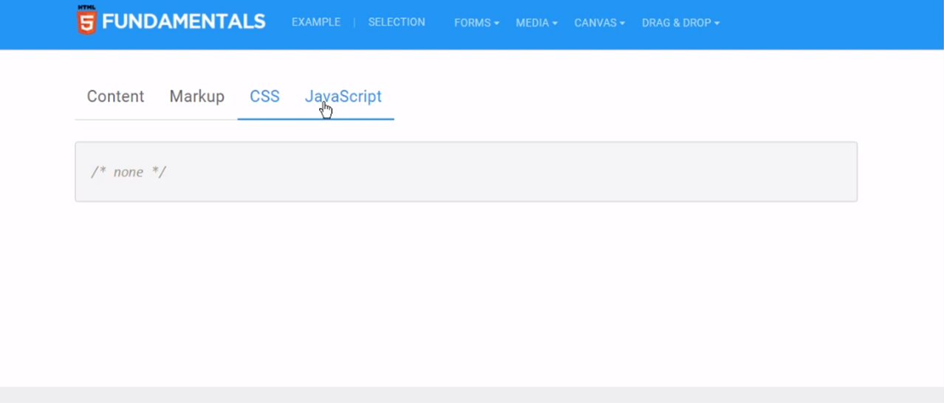

Slide 7
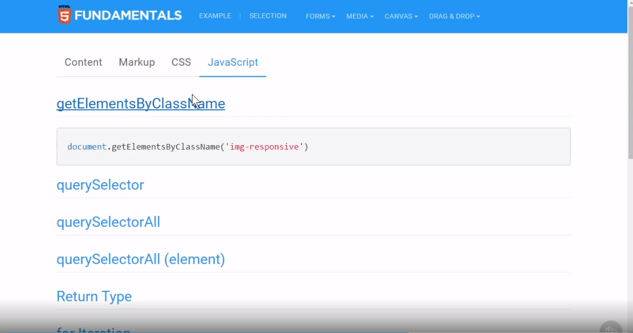

Slide 8
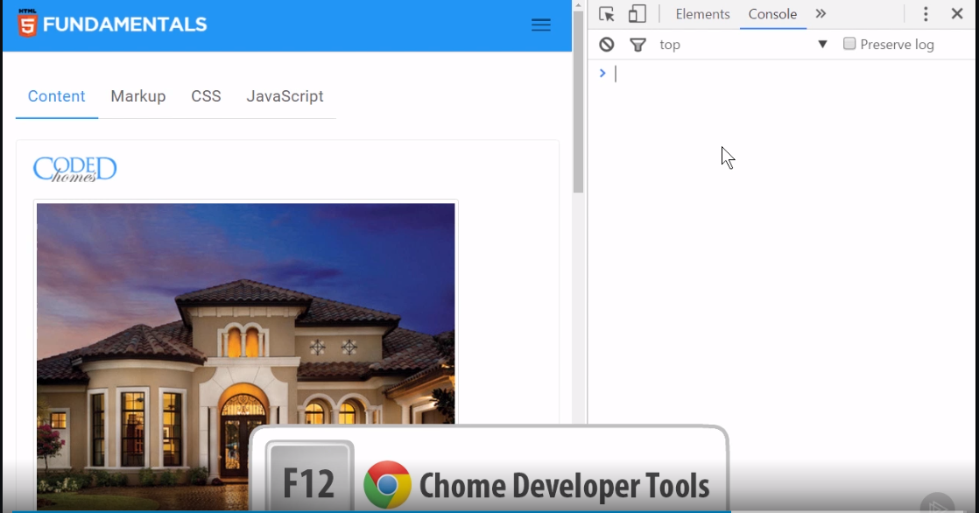

Slide 9
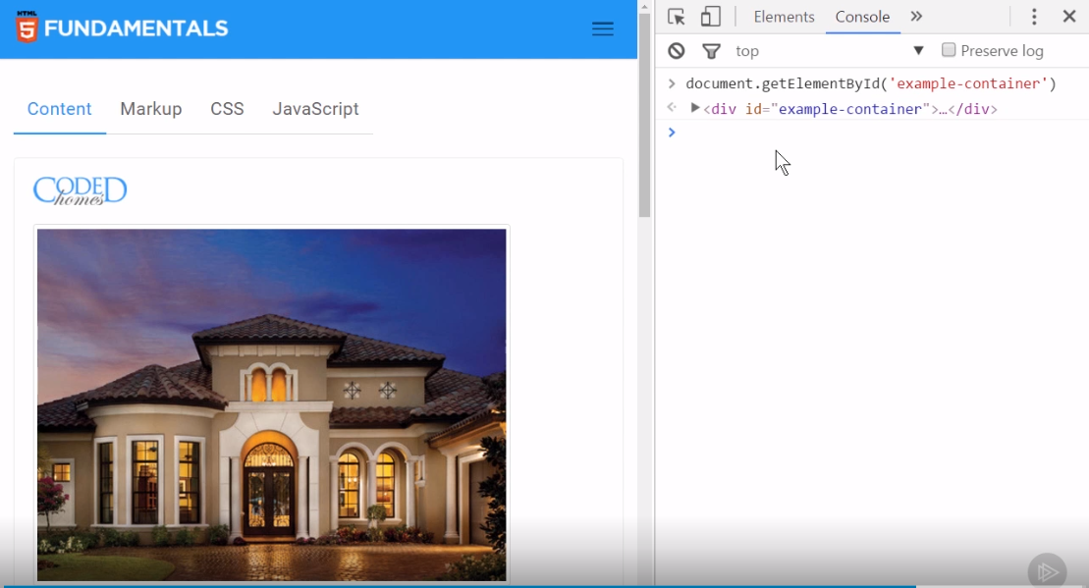

Slide 10




Slide 11







Slide 12
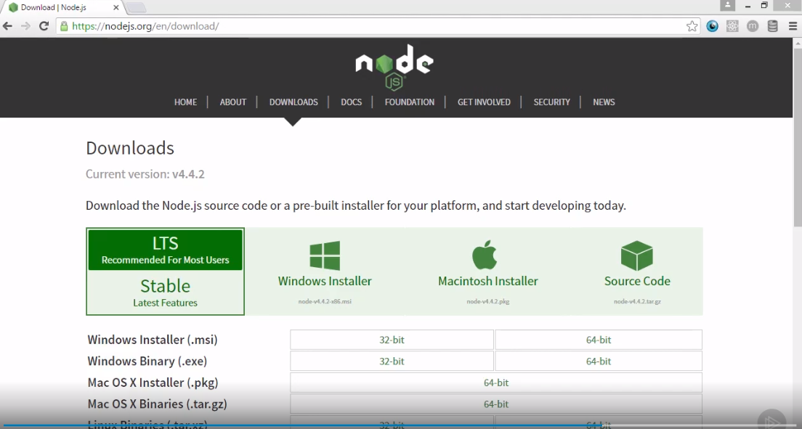

Slide 13



Slide 14


<html>
<body>
<header>...</header>
<main>...</main>
<footer>...</footer>
</body>
</html>

Slide 15
<html>
<body>
<div id="header">...</div>
<div id="main">...</div>
<div id="footer">...</div>
</body>
</html>

Slide 16
<html>
<body>
<header>...</header>
<main>...</main>
<footer>...</footer>
</body>
</html>

Slide 17









Slide 18













Slide 19



Slide 20
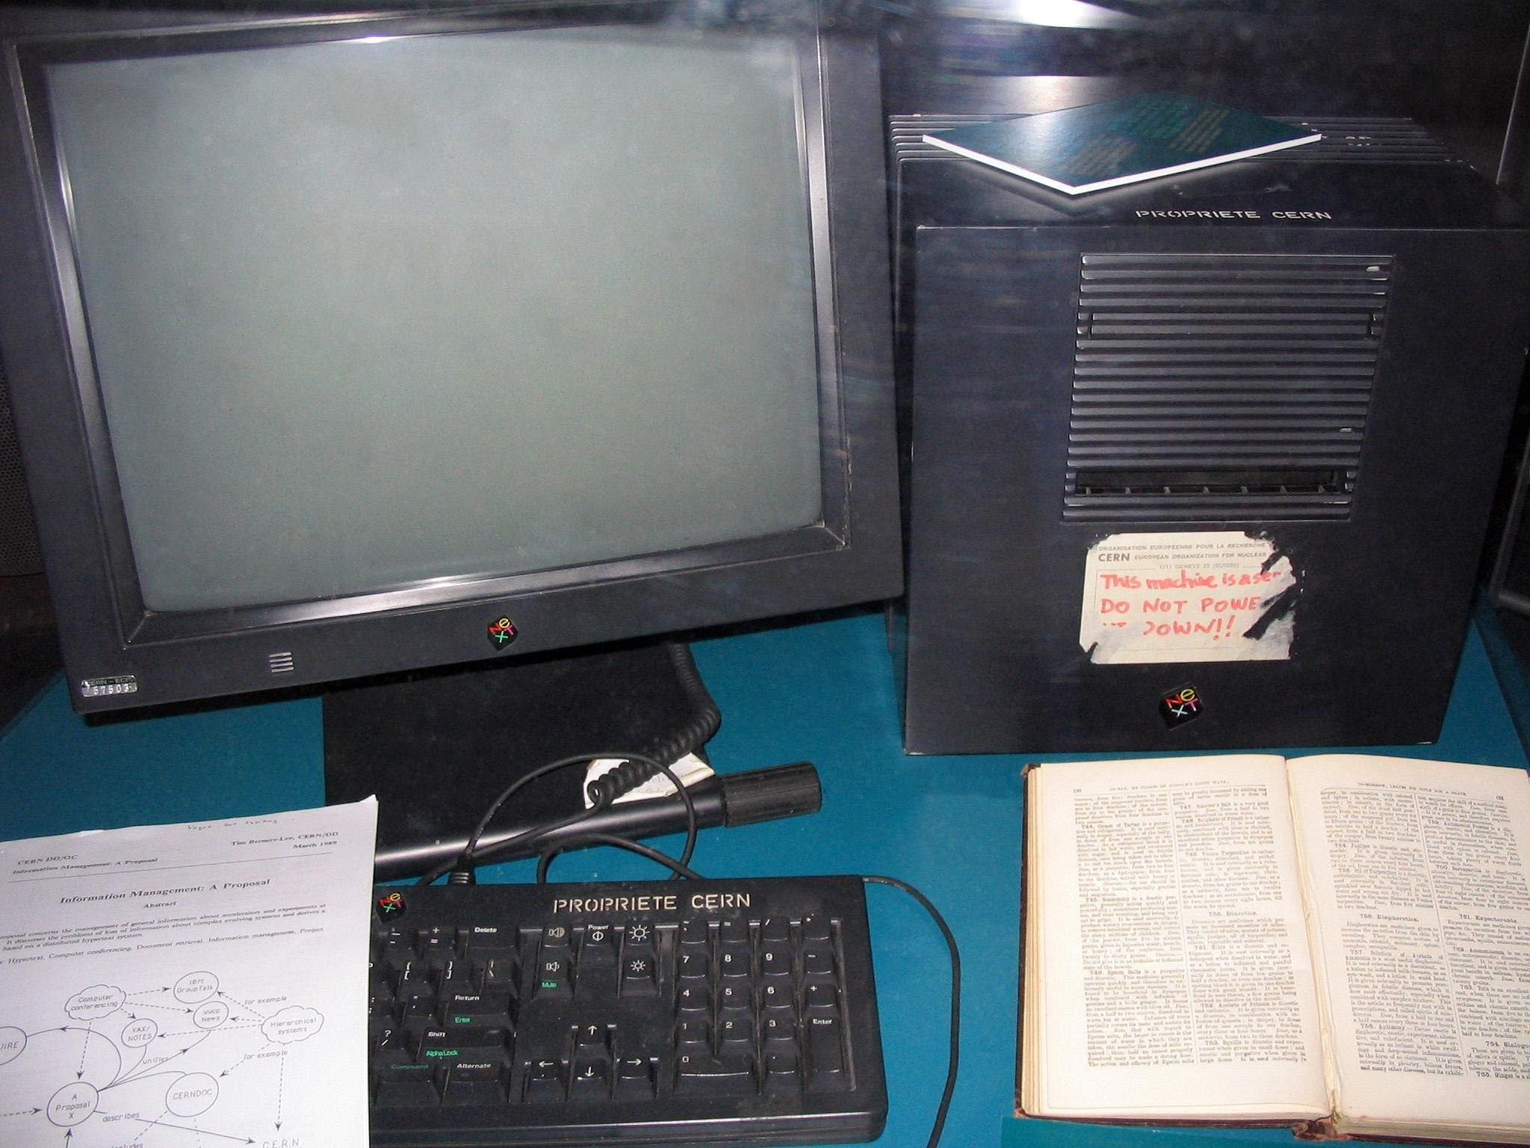


Slide 21





Slide 22


Slide 23


Slide 24


Slide 25



Slide 26


Slide 27



Slide 28



Slide 30
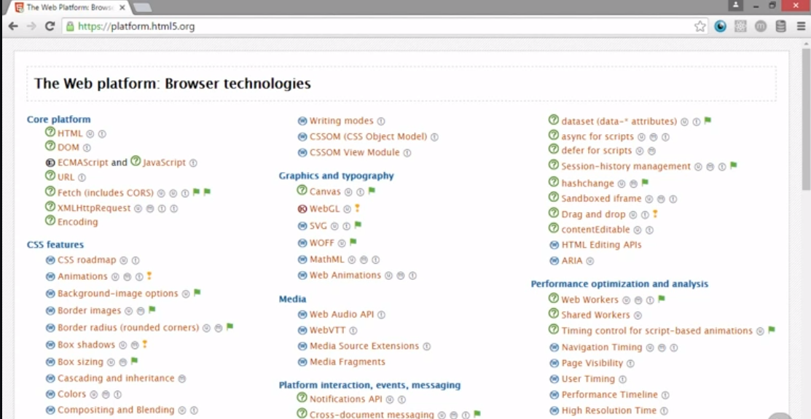

Slide 31








Slide 32


Slide 33




Slide 34




Slide 35



Slide 36


Slide 37


Slide 38





























Slide 39



<main></main>

Slide 40

cle>
<article></arti

Slide 41

<aside></aside>

Slide 42

>
<section></section

Slide 43


<header></header>
<footer></footer>

Slide 44

<nav></nav>

Slide 45
<html>
<body>
<header>
<nav>...</nav>
</header>
<main>
<article>
<section>...</section>
<aside>...</aside>
</article>
</main>
<footer>
<nav>...</nav>
</footer>
</body>
</html>

Slide 46

<time
date="2016-08-12" pubdate> August 12, 2016
</time>

Slide 47


<figure>
<figcaption>
Screenshot of Menu
</figcaption>
<img src="screenshot.png">
</figure>

Slide 48


<details>
<summary>Events</summary>
<p>Come join us.</p>
</details>

Slide 49

<mark>
highlighted text
</mark>

Slide 50

<bdi>!םלוע םולש</bdi>

Slide 51

Honorificabili<wbr> tudinitatibus

Slide 52

<output></output>

Slide 53

<embed
src="intro.mov">

Slide 54

<canvas></canvas>

Slide 55



<video>
<source src="vid.mp4">
<source src="vid.ogg">
<source src="vid.webm">
<track
kind="subtitles"
label="Spanish Subtitles" src="es.vtt" srclang="en">
</video>

Slide 56

<meter
min="0"
max="100"
value="70">
70 out of 100
</meter>

Slide 57

<progress max="100" value="50">
</progress>

Slide 58

<math>
<!-- MathML elements -->
</math>

Slide 59

<input
type="text" list="colors" min="70">
<datalist id="colors">
<option src="blue">
<option src="red">
</datalist>

Slide 61













Slide 62


Slide 63
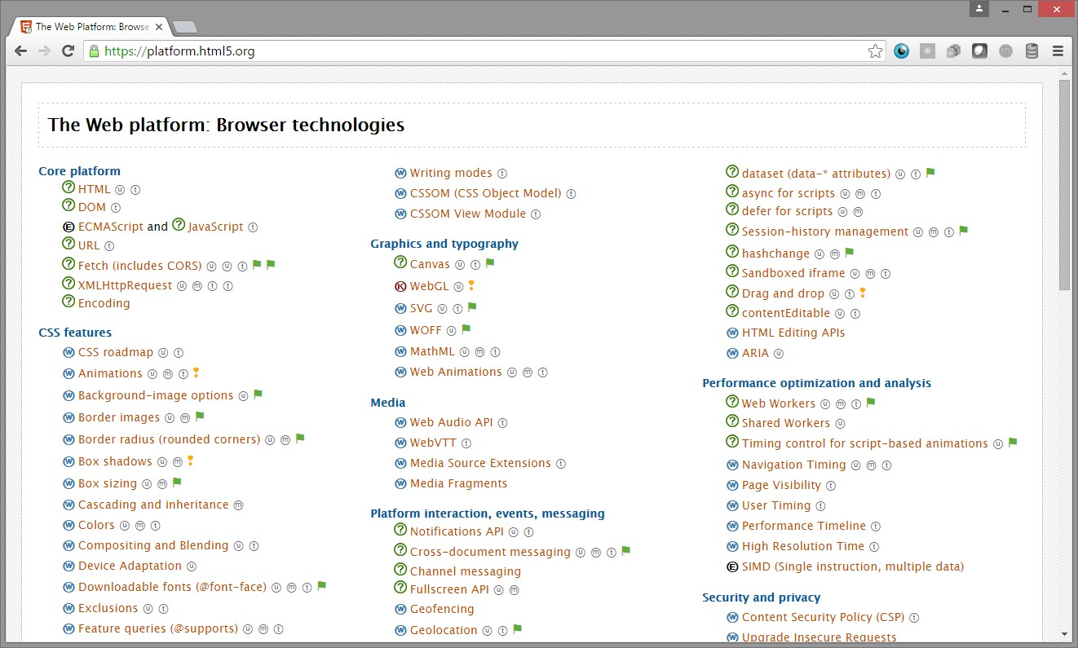

Slide 64





Slide 65














Slide 66











Slide 67












Slide 68












Slide 69





Slide 70

<div id="comment-container">
<div class="comment">
<div class="user-info-container">
<div class="user-name">Craig Shoemaker</div>
<div class="avatar"><img src="images/cs.png"
width="100" height="100" alt="Craig Shoemaker" />
</div>
</div>
<div class="content-container">
<div class="publish-date">12/01/2016</div>
<div class="content">HTML5 is a set of markup enhancements
and new JavaScript APIs</div>
</div>
</div>
</div>

Slide 71

<comments>
<comment author="Craig Shoemaker" avatarUrl="images/cs.png" publishDate="12/01/2016">
HTML5 is a set of markup enhancements and new JavaScript APIs.
</comment>
</comments>

Slide 72





Slide 73












Slide 74









Slide 75
















Slide 77


Slide 78


Slide 79
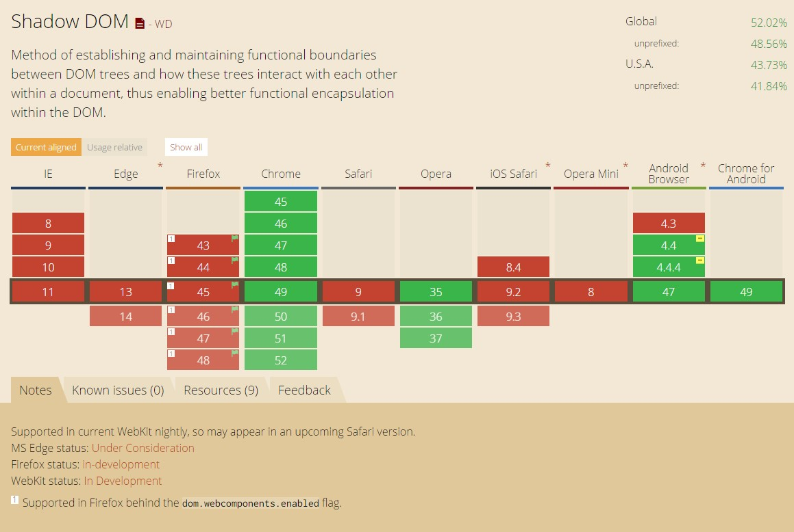



Slide 80





Slide 81


Slide 82





Slide 83


Slide 84


Slide 85


Slide 86


Slide 87


Slide 88



Slide 89



Slide 90


Slide 91





Slide 92








